Slide 1
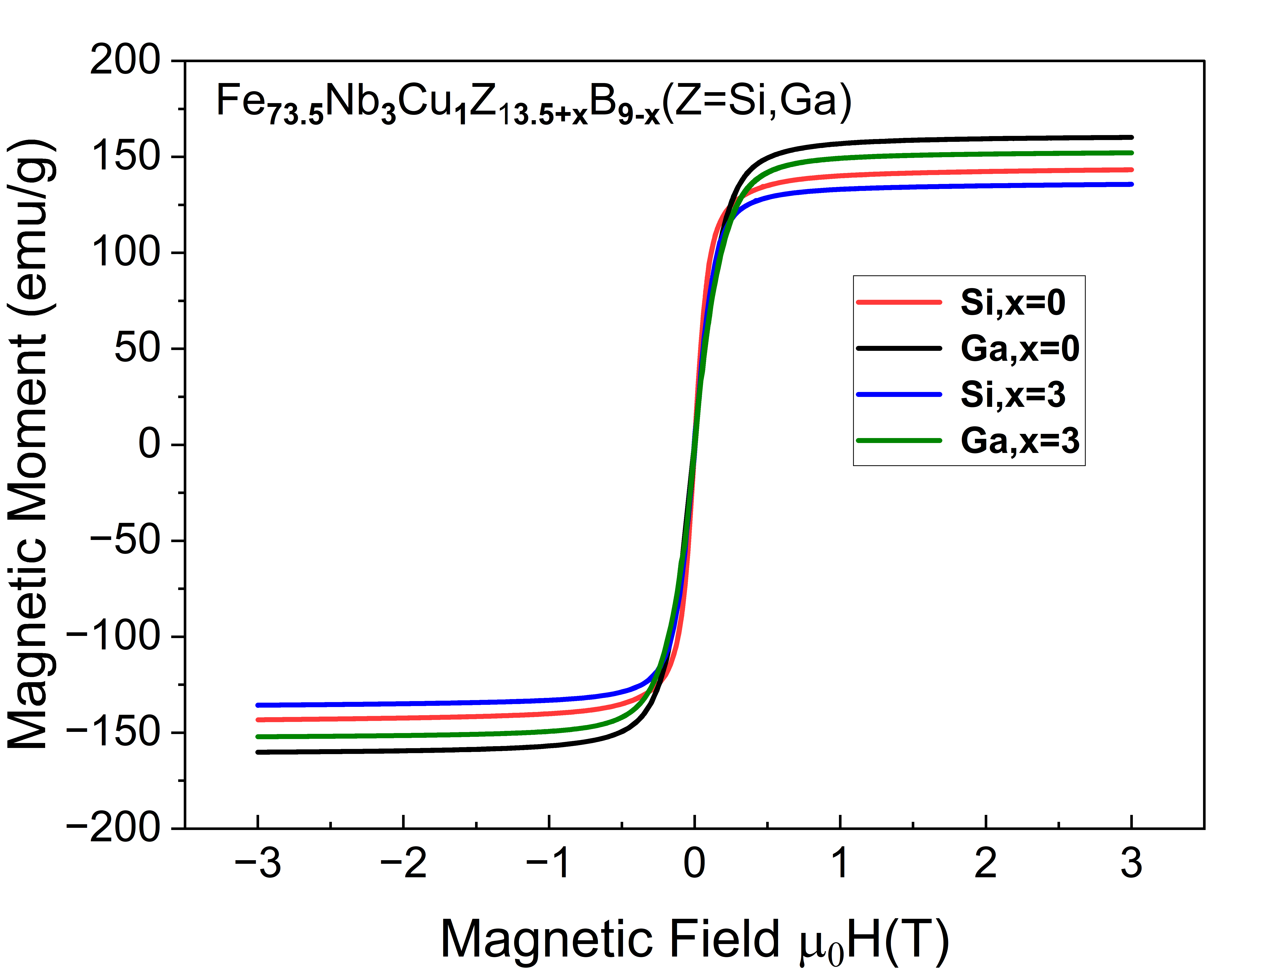
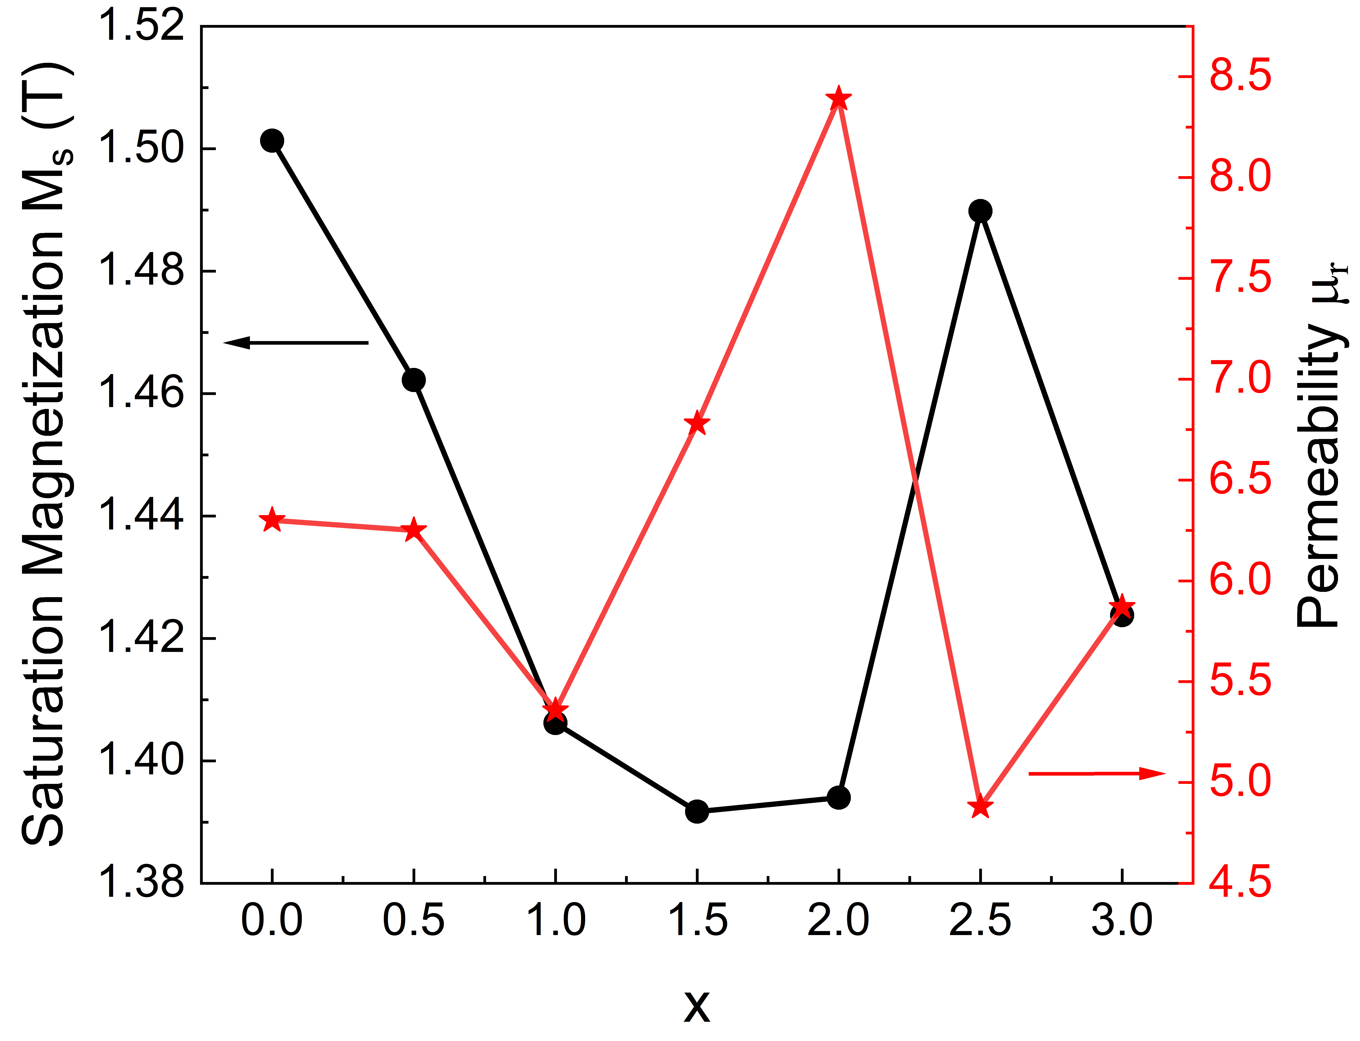
Compositional design of soft magnetic Fe_{73.5}Nb₃Cu₁Z_{13.5+x} B_{9-x} (Z = Si, Ga) alloys for energy applications
Manish Neupane, Cole Brown, Mohd Anas, and Parashu Kharel
Department of Chemistry, Biochemistry, and Physics, South Dakota State University, Brookings, SD 57007, USA
Background
Magnetic Properties
Structural Properties
Fgi
Soft magnetic materials can be easily magnetized/de-magnetized. They are integral components of power electronics.
These alloys can be used in a variety of applications due to favorable properties such as low coercivity, low remanence, high saturation magnetization and high magnetic permeability.
These materials can be cast into amorphous ribbons for use in devices such as transformers and inductors, but bulk samples can be used to study the resulting crystal structures as well as other properties. [1]
Ga & Si are present to mediate vitrification of the alloy and reduce magnetic anisotropy, while boron stabilizes the resulting amorphous structure. [2]
Changes in crystalline structure may lead to observable changes in the magnetic properties of the synthesized materials.
We have synthesized the Fe_{73.5}Nb₃Cu₁Z_{13.5+x}B_{9-x} alloys with x = 0, 0.5, 1, 1.5, 2, 2.5, and 3, and investigated their crystal structures and magnetic properties.
Z=Ga
Z=Si
The peaks (110), (200), and (211) are consistent with the body-centered cubic crystal structure of Fe₃Si.
In x = 0 and 0.5, extra peaks to the left of peak (110) appear, signifying some sort of additional phase.
All alloys in the series demonstrate small hysteresis loops, making coercivity and remanence difficult to accurately determine.
x = 0 (Z = Ga) shows the highest saturation magnetization,
while x = 3 (Z = Si) has the lowest.
The saturation magnetization is larger for Z = Ga, as compared to Z = Si for all compositions.
x = 2 (Z = Ga) shows the highest slope (permeability), while x = 2.5 has the smallest.
Conclusions
Bulk Fe_{73.5}Nb₃Cu₁Z_{13.5+x}B_{9-x} (Z = Si, Ga) alloys were synthesized using arc-melting and annealing.
As x increases, saturation magnetization decreases for both the series of compounds (except x = 0.25).
Values of coercivity and remanence are too small to be known with certainty.
Permeability does not seem to follow any trend with x.
Highest value of relative permeability is found for x = 0.25 in Fe_{73.5}Nb₃Cu₁Ga_{13.5+x}B_{9-x} and x=0 in Fe_{73.5}Nb₃Cu₁Si_{13.5+x}B_{9-x}.
For x = 0 and 0.5 (in Z= Si), additional phases appear, meaning higher quality samples will need to be made to produce better properties.
In order to better understand the effect of changes in Ga (Si) and B concentration, amorphous and nanocrystalline alloy ribbons will be made and studied.
Experimental Methods
Z=Si
Z=Si
The metal pieces required for the synthesis of each sample were cut from commercially available high-purity pellets or fragments.
The alloys were synthesized in a water-cooled copper-hearth of arc-melter under an argon atmosphere.
The synthesized ingots were annealed at 600°C for 24 hours in a tube furnace in vacuum.
X-Ray diffraction measurements were performed on each sample to study their crystal structures using the Rigaku MiniFlex 600 X-Ray Diffractometer.
Magnetic measurements were made on each sample using the Quantum Design VersaLab Magnetometer.
Acknowledgments
This research is supported by NASA grant number 80NSSC21M0326. M. Anas is supported by DOE EPSCoR (DE-SC0024284) grant.
The alloy with Z = Si demonstrates transitions at
temperatures of roughly 500 K and 675 K.
In x = 3, the same transition can be seen at 500 K, but
the transition at 675 K does not appear.
For both materials, the Curie Temperature appears to
be at roughly 900 K.
The observed high Curie Temperature is likely due to Iron-Silicon phases other than the expected Fe₃Si.
As x increases, a decrease in saturation magnetization appears.
Permeability does not seem to show any particular trend
with x.
These values are likely to deviate to some extent from amorphous and nanocrystalline alloys.
References
J. M. Silveyra et al., Soft magnetic materials for a sustainable and electrified world, Science 362, eaao0195 (2018).
Y. Wang, Y. Zhang, A. Makino, Y. Kawazoe, First principle study on the Si effect in the Fe-based soft magnetic nano-crystalline alloys, J. Alloys Compd. 730, 196-200 (2018) .

